Slide 1
S-129 UKCM Test Presented by KHOA
S-129 Project Team Meeting

Slide 2
KHOA S-100 test bed
Reference Doc. for S-129 Test
S-97 Product Specification Guideline
S-100 Test Bed Platform(S-100WG-TSM6_6.1.a)
S-100 infrastructure and development tools
S-100 GI Registry
S-100 Feature Catalogue Builder
S-100 Portrayal Catalogue Builder
SVG Editor
Interoperability Catalogue Editor
Exchange set Editor
DCEG Builder
S-100 Viewer

Slide 3
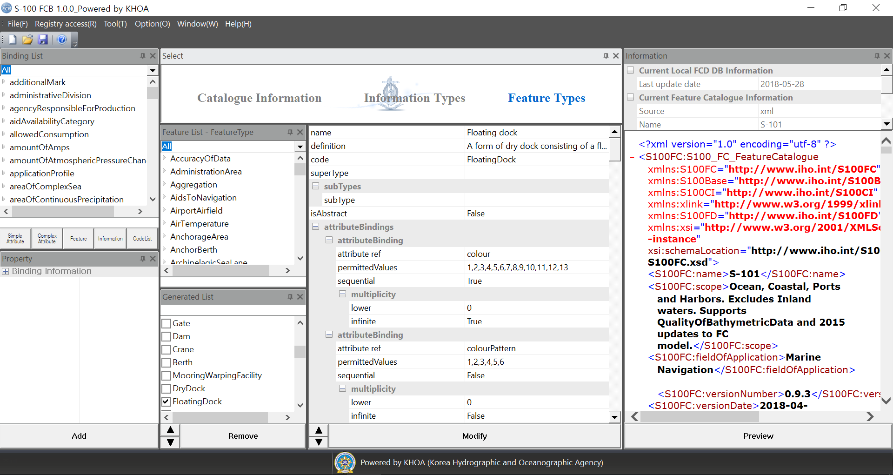
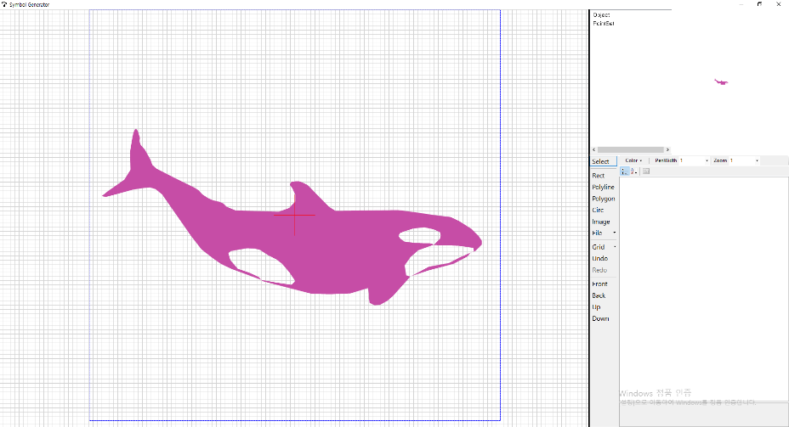
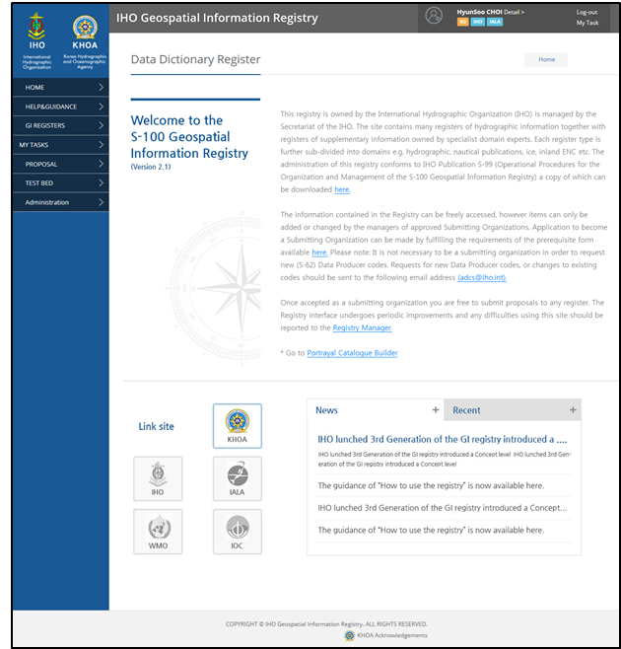
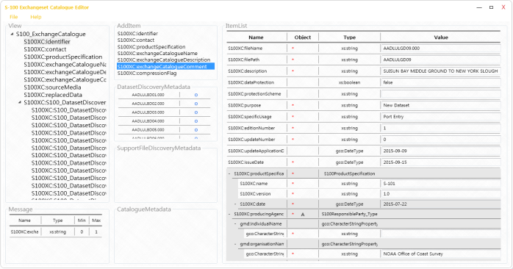
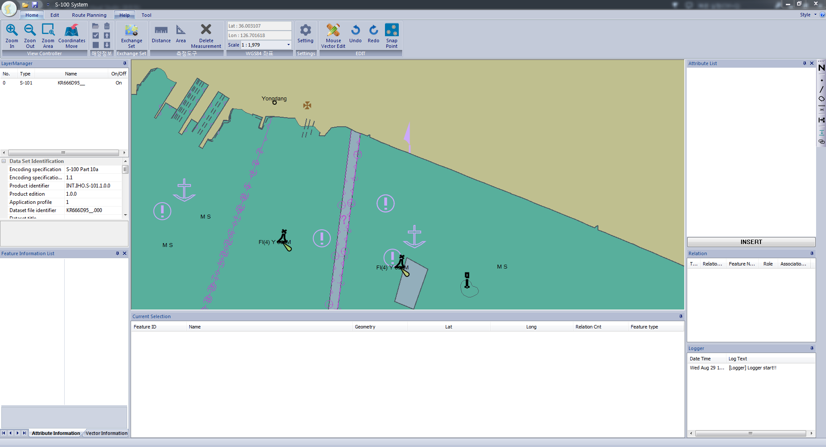
KHOA S-100 test bed
S-100 FCB/PCB
S-100 Symbol Editor
GI Registry
Exchange set Editor
S-100 Viewer

Slide 4
KHOA S-100 test bed
S-100 test bed platform
Designed from the experience of developing S-100 infra and tools
FCB
Loading Symbol
SVG
Editor
Line Sym.
Editor
Pattern
Editor
Checking symbol
Portrayal
Register
S-100 based PS
TDS
Symbol
PCB
FC/PC
FC
FC DB
Loading Exchange set
Include IC
Exchange set
Editor
S-100 Viewer
Loading existing FC/PC
Product
Register
IC Editor
Interoperability Catalogue
Loading IC
Testbed Project
DB
Save Exchange set
Save Plotting Image

Slide 5
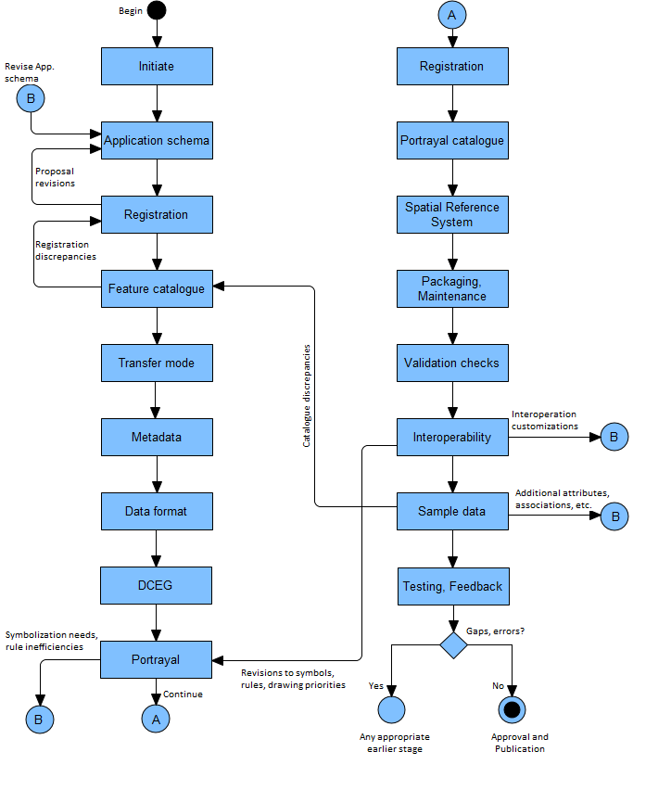
S-100 Product specification development process
S-97 IHO GUIDELINE FOR CREATING S-100 PRODUCT SPECIFICATIONS PART B Execution
Registry
SVG Editor
Modelling Tools
PCB
Registry
FCB
Exchange editor
IC Editor
GML Editor
DCEG Editor
S-100 Viewer

Slide 6
Test plan
S-129 UKCM Test plan (including S-421 Route)
Step 1 : Review of S-129/S-421 Application schema
Step 2 : Testing S-129 FC and PC (Drafted by KMOU)
Step 3 : Drafting S-421 FC / PC
Step 4 : Creating S-129 TDS
Step 5 : Creating S-421 TDS
Step 6 : Testing S-129 TDS and S-421 TDS by S-100 Viewer
Step 7 : Discussion of the test results
Step 8 : Identification of requirements for further test
Step 9 : Apply new requirements to the system
Step 10 : Review and discuss the test results

Slide 7
Review of application schema
Application schema of S-129 UKCM

Slide 8
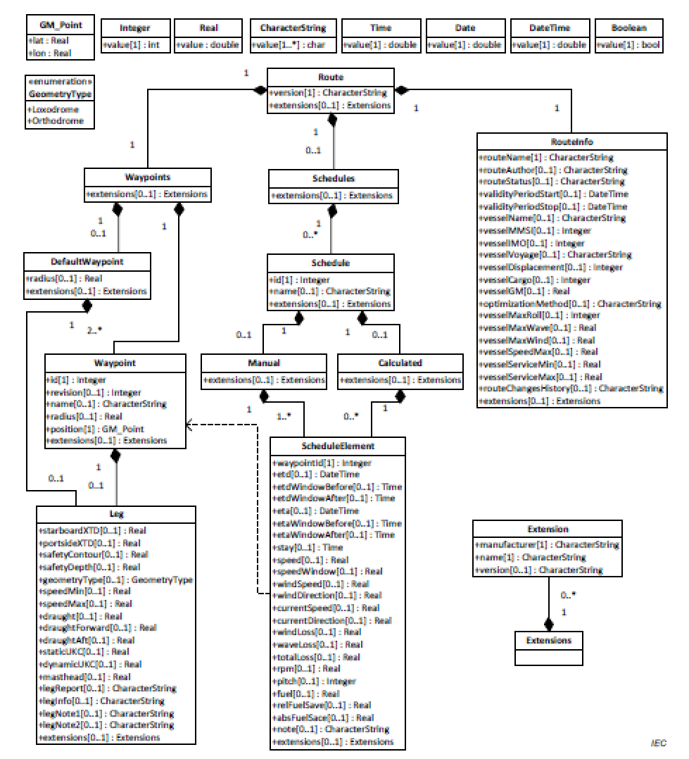
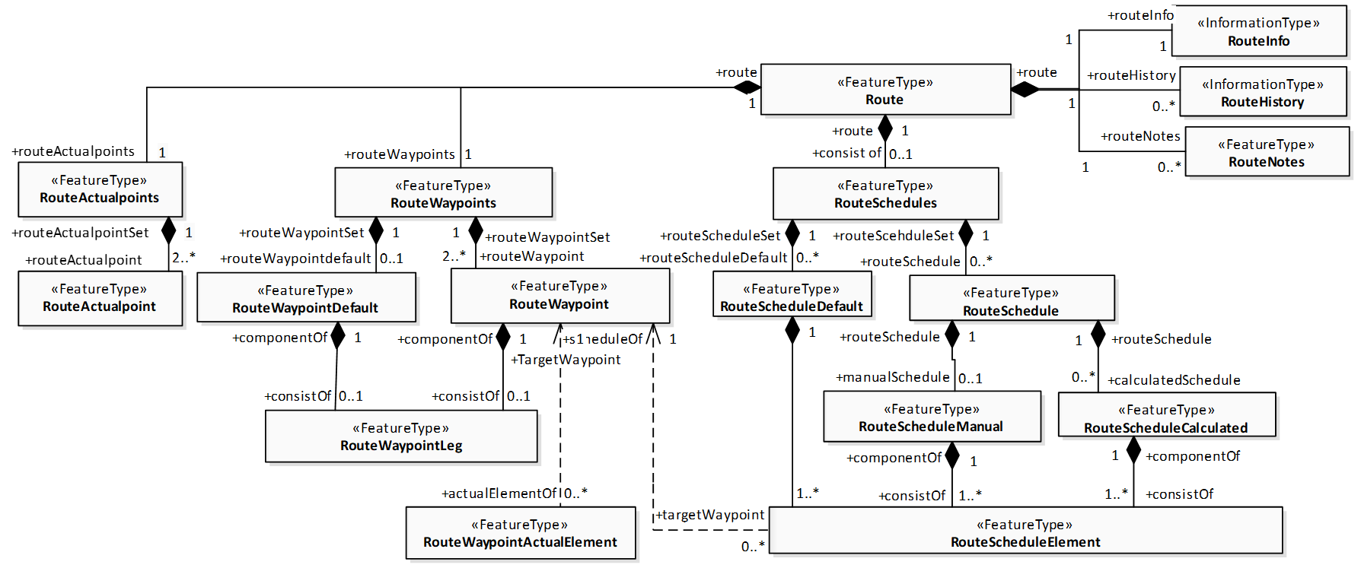
Review of application schema
Application schema of S-421 Route (RTZ vs. S-421)

Slide 9
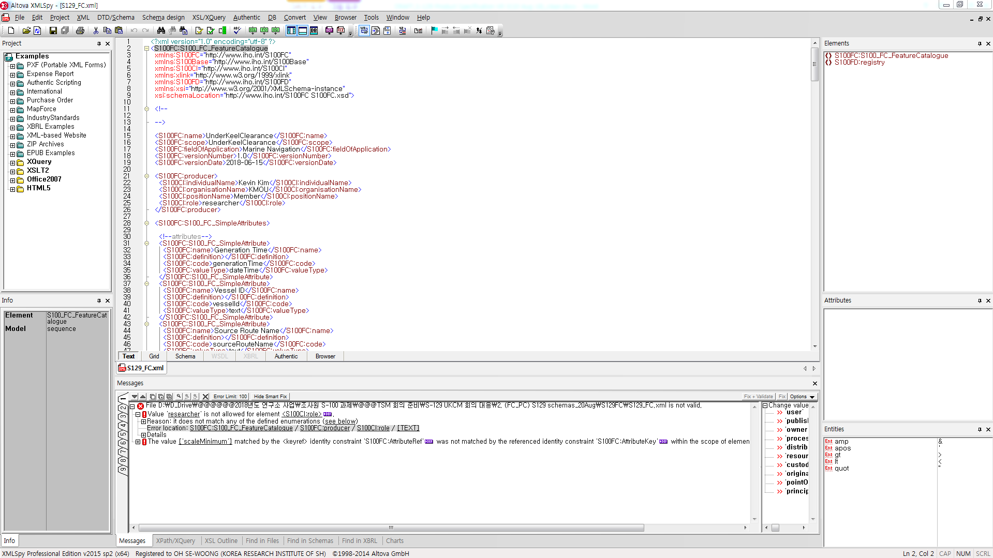
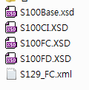
Testing S-129 FC and PC
S-129 Feature Catalogue
Validation check / S-100 Viewer check

Slide 10
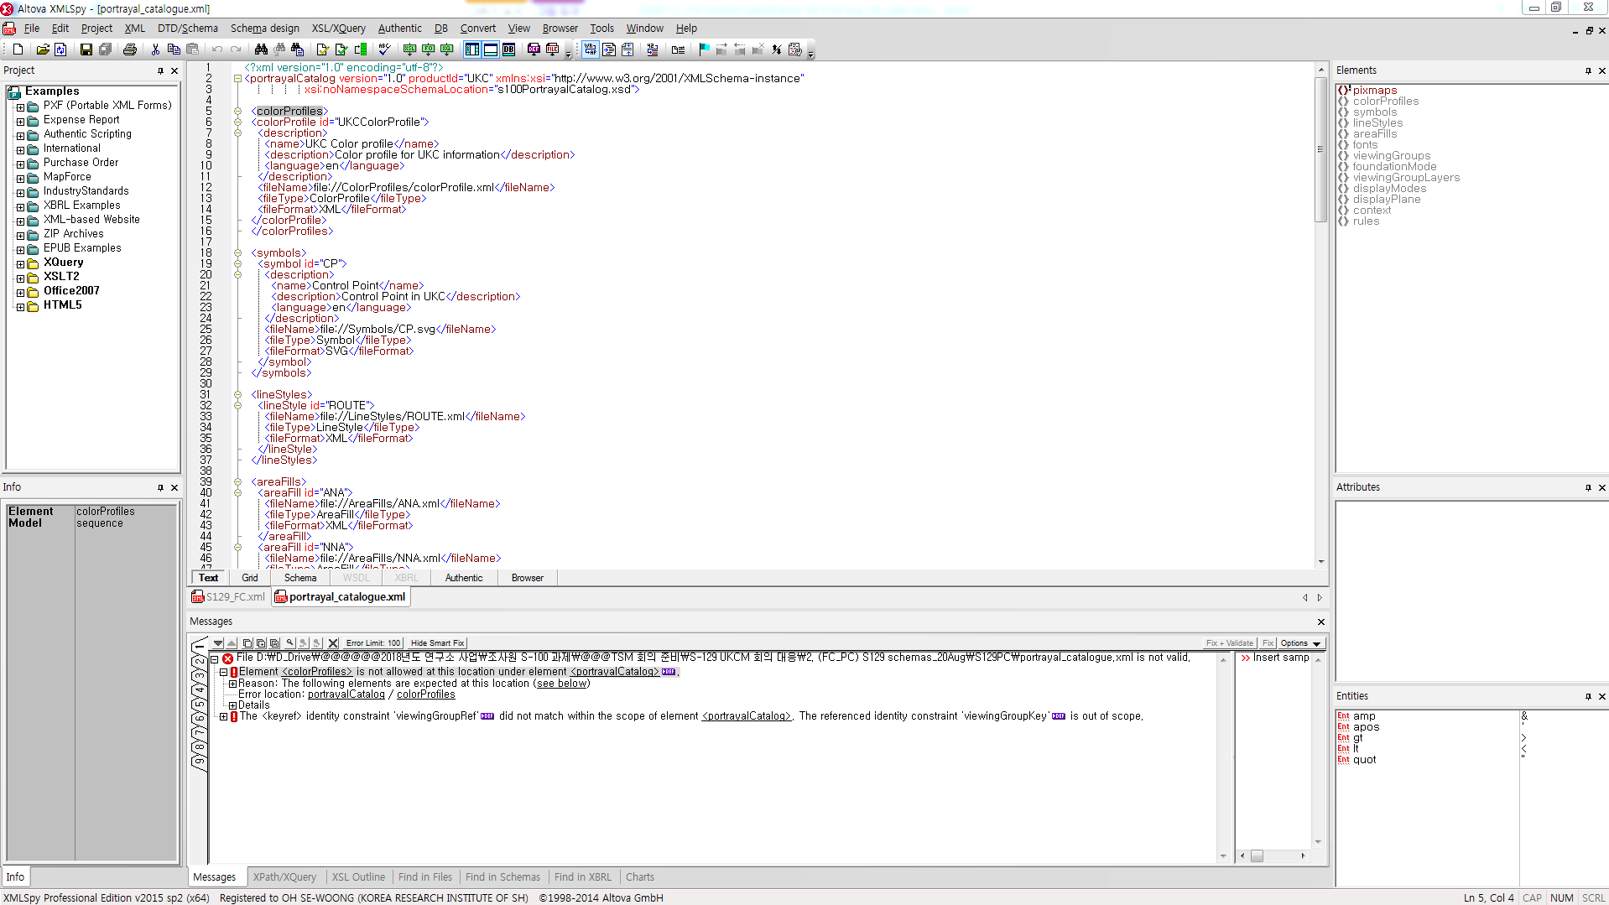
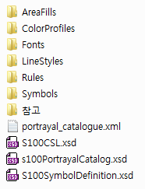
Testing S-129 FC and PC
S-129 Portrayal Catalogue
Validation check

Slide 11
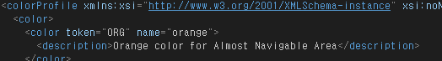
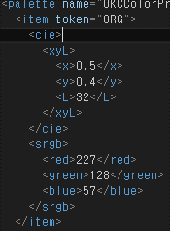
Testing S-129 FC and PC
S-129 Portrayal Catalogue
S-100 Viewer check – colorProfile.xml
Change tag <color> to tag <colors>
Change UTF-8 save to Ansi save
Item token

Slide 12
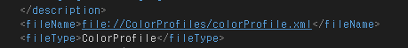
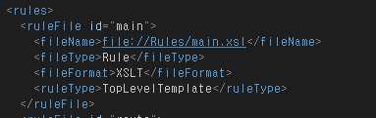
Testing S-129 FC and PC
S-129 Portrayal Catalogue
S-100 Viewer check – portrayal_catalogue.xml
Pcbinfo information missing
Change productID to “S-129”
Delete file:// in the fileName
Modify <ruleType>TopLevelTemplate</ruleType>

Slide 13
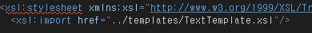
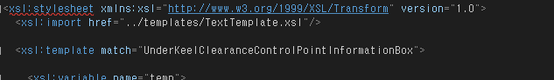
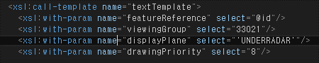
Testing S-129 FC and PC
S-129 Portrayal Catalogue
S-100 Viewer check – Feature XSL Files
Import directory change ../ -> ./
UnderKeelClearanceControlPointInformationBox
There is not such feature type,
no method to portray the time window
Change from stylesheet to transform
Display priority (3->9, 4->12, 8->24)

Slide 14
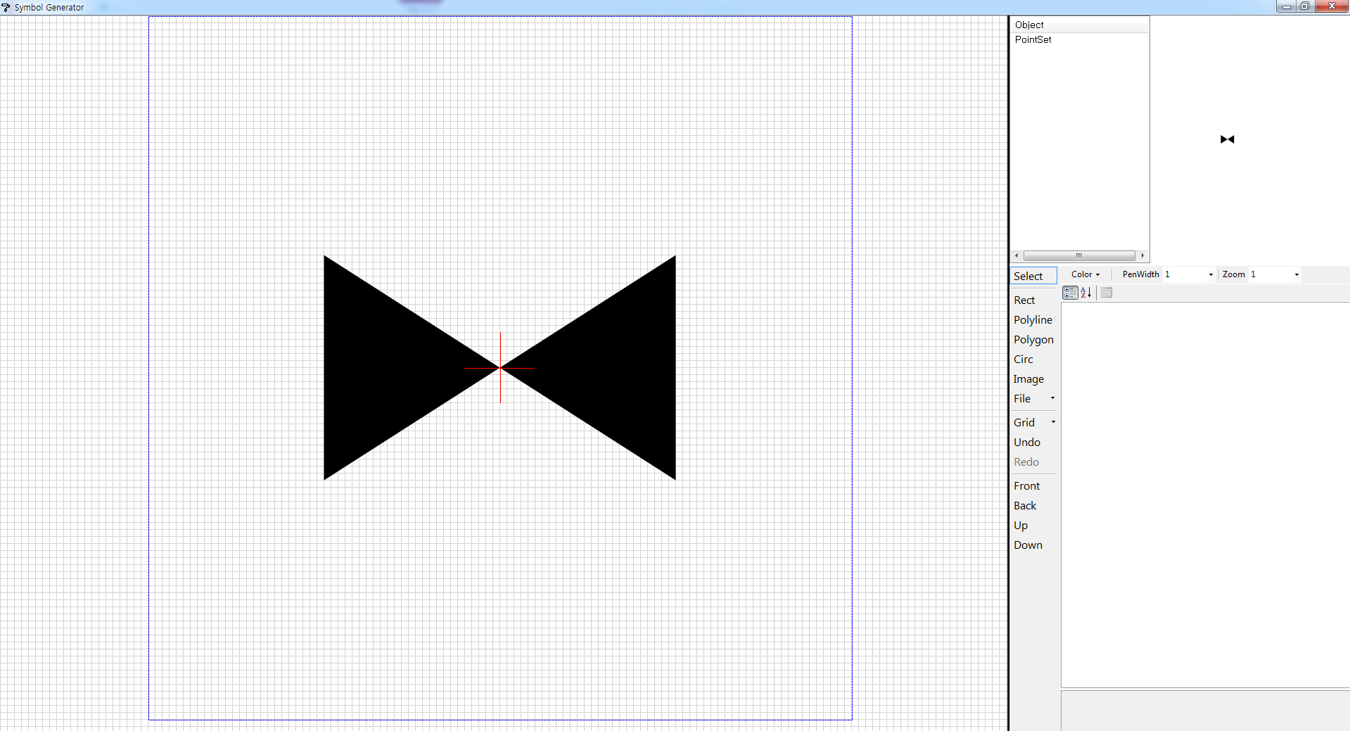
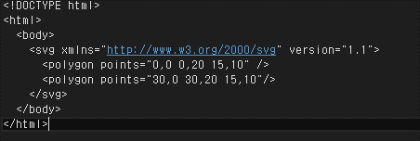

Testing S-129 FC and PC
S-129 Portrayal Catalogue
S-100 Viewer check – SVG Symbol
SVG Symbol – created by polygon
S-100 uses path tag on it
Didn’t follow the S-100 profiled SVG

Slide 15
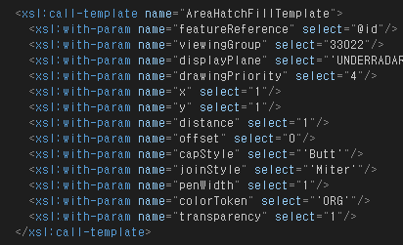
Testing S-129 FC and PC
S-129 Portrayal Catalogue
S-100 Viewer check – Drawing Instruction (Output XML)
S-129 PC Rule used HatchFill
KHOA S-100 Viewer don’t support it
Change it as Pattern Fill

Slide 16
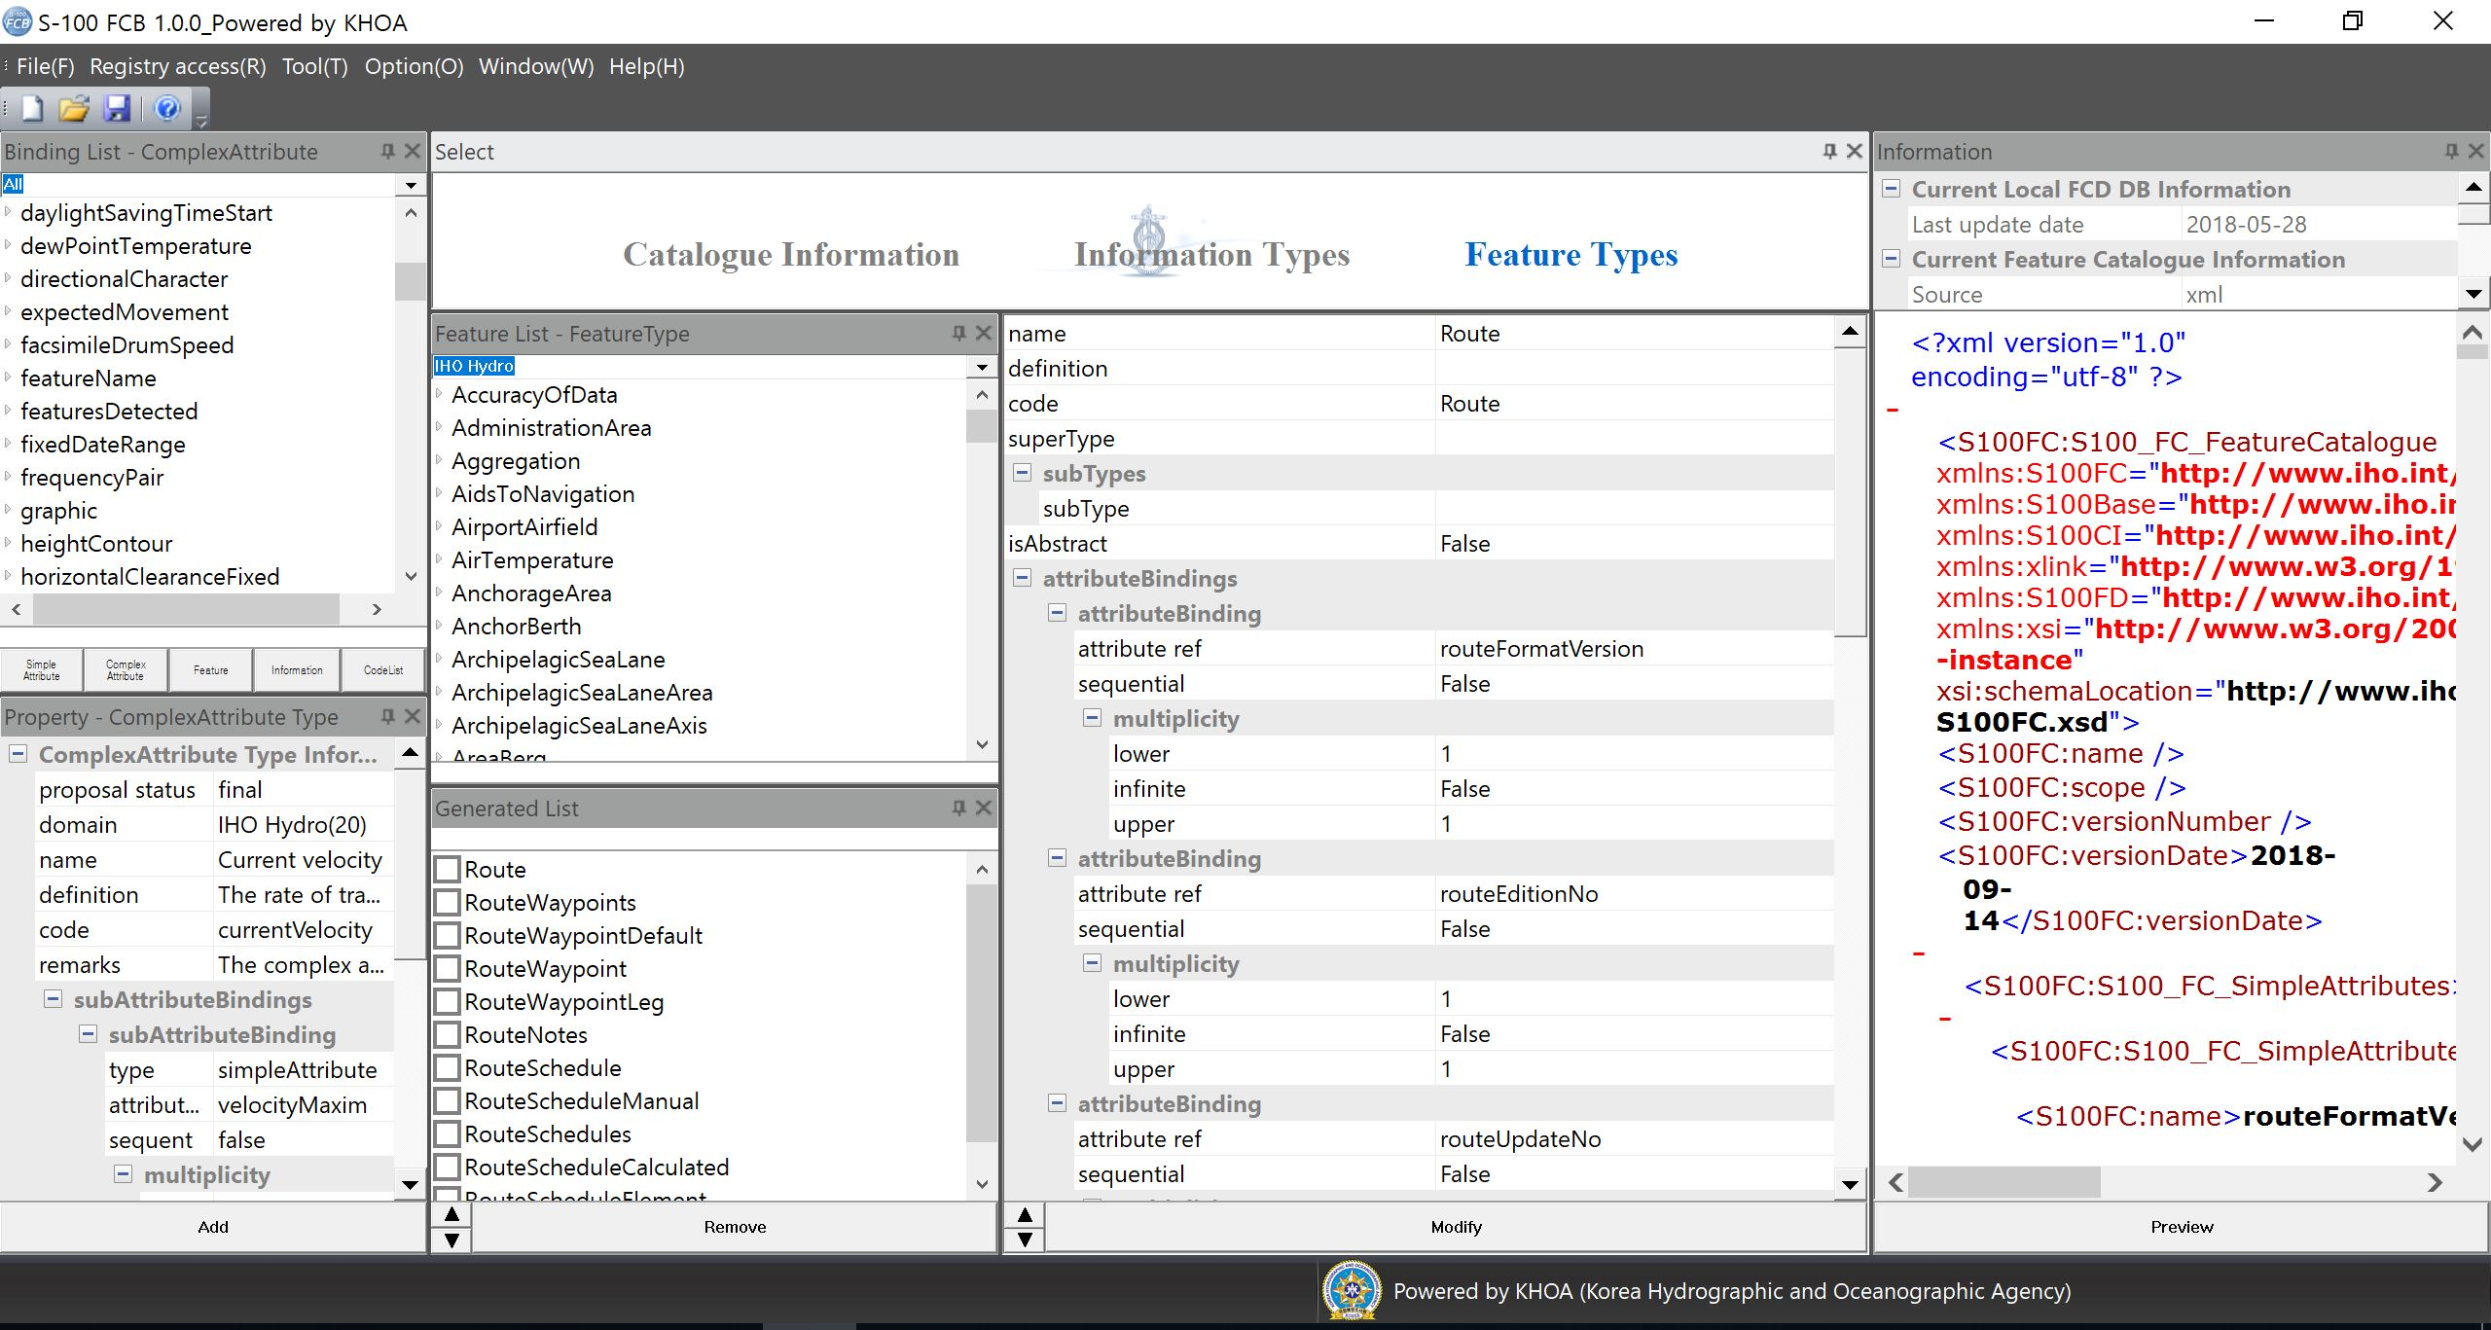
Drafting S-421 FC / PC
S-421 Feature Catalogue

Slide 17
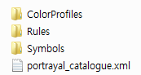
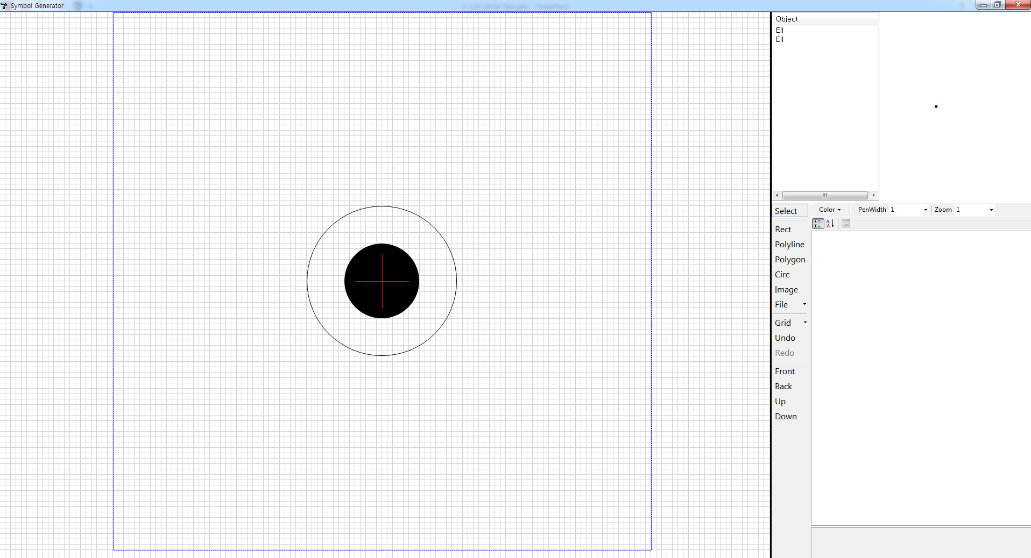
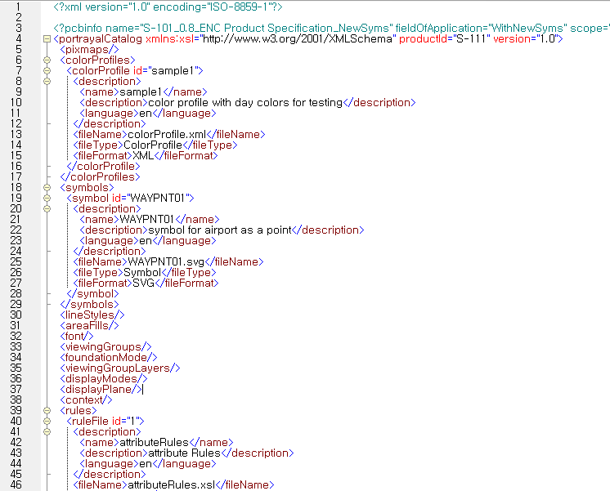
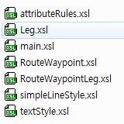
Drafting S-421 FC / PC
S-421 Portrayal Catalogue

Slide 18
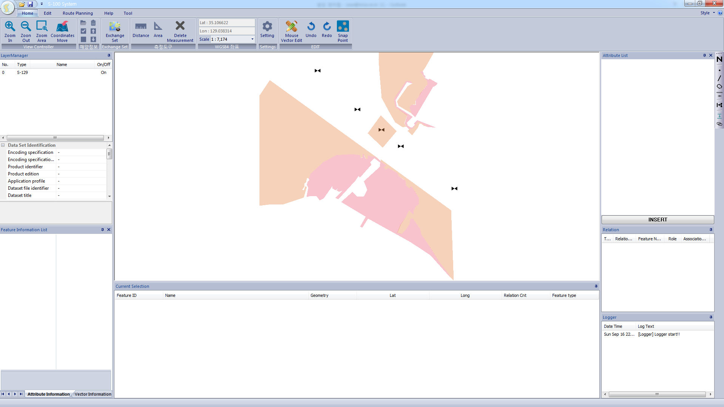
Creating S-129 UKCM/S-421 Route TDS
KHOA Simple Editor (S-129 UKCM TDS)

Slide 19
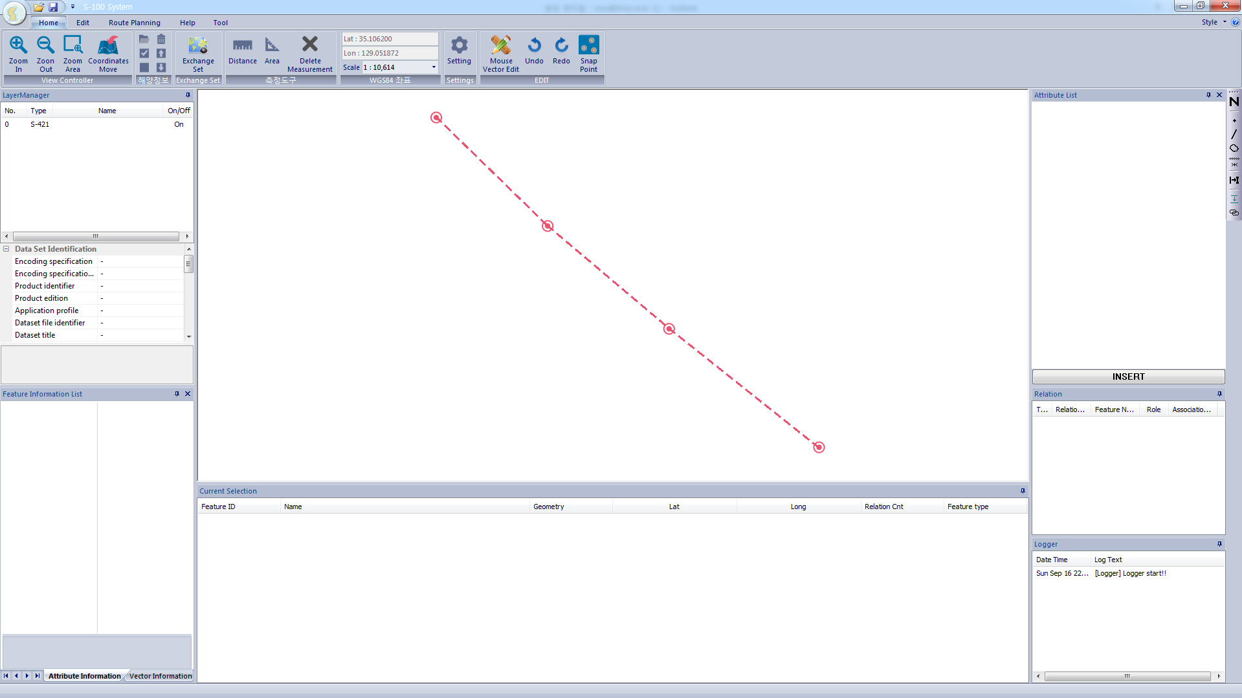
Creating S-129 UKCM/S-421 Route TDS
KHOA Simple Editor (S-421 Route TDS)

Slide 20
Testing S-129/S-421 TDS by S-100 Viewer
Testing Process
S-129 UKCM
FC / PC
S-421 Route
FC / PC
S-129 UKCM
TDS
Plotting
Result
S-421 Route
TDS
S-101 ENC
(KR5G3B33)

Slide 21
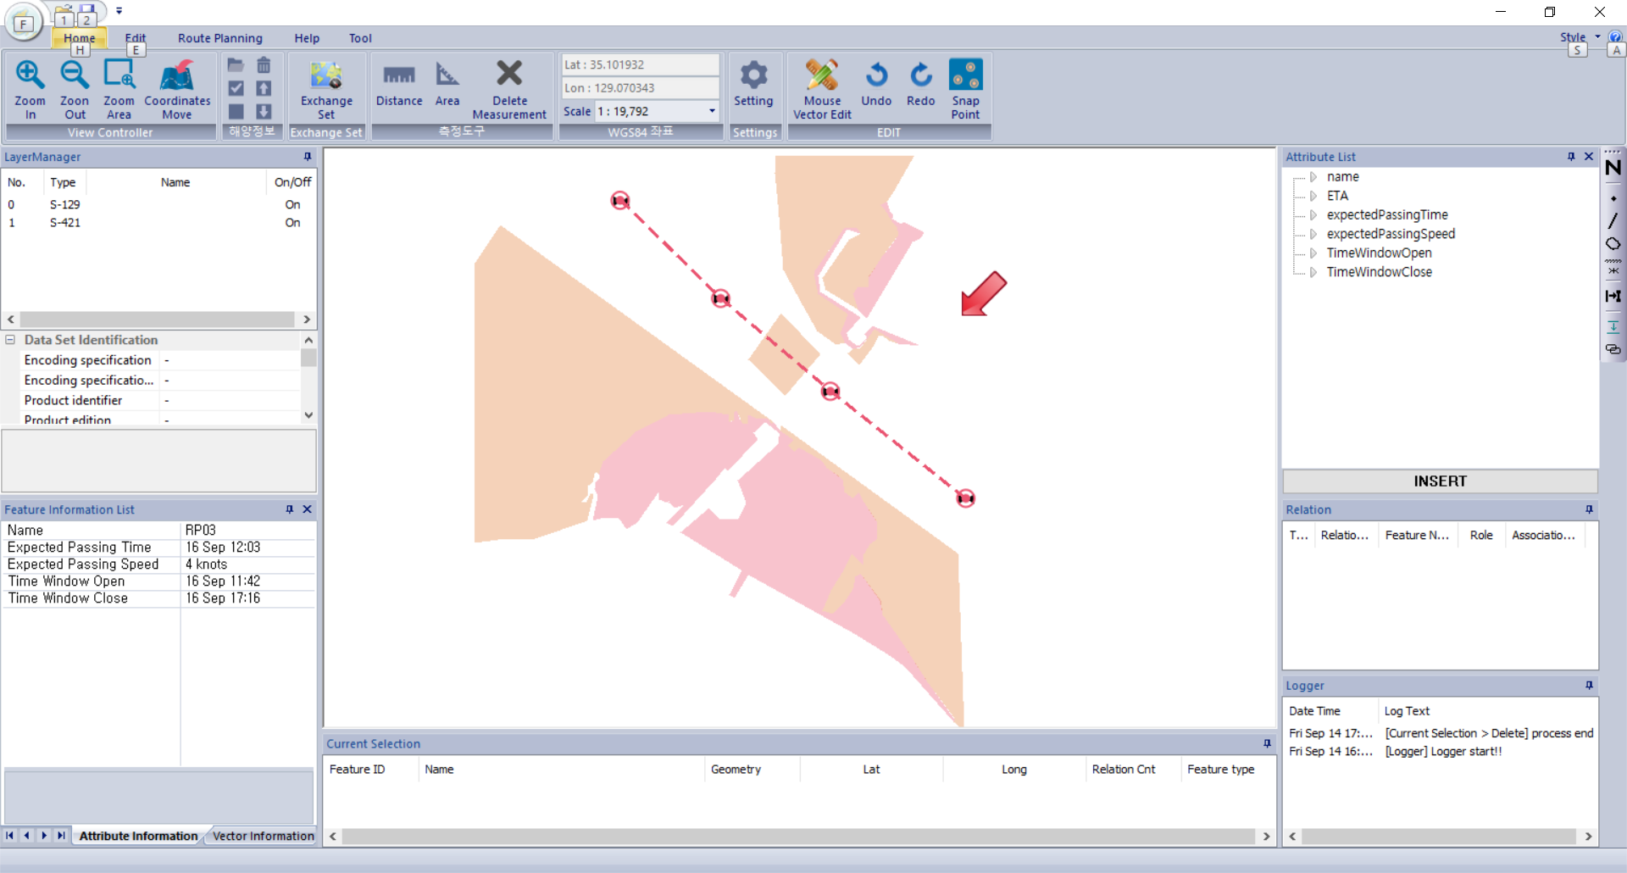
Testing S-129/S-421 TDS by S-100 Viewer
Plotting result without S-101 ENC

Slide 22
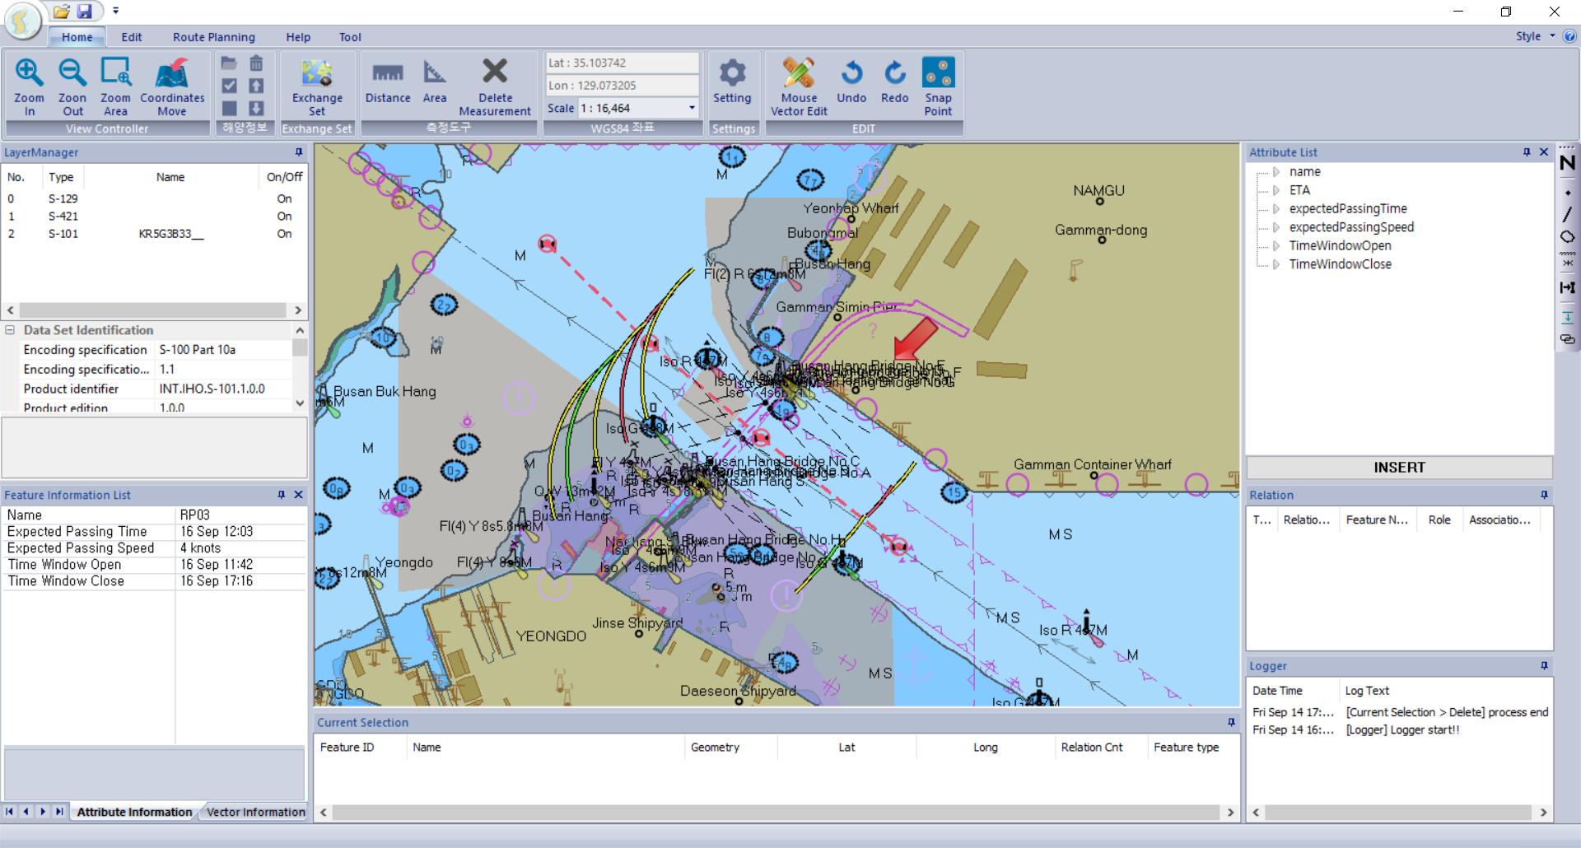
Testing S-129/S-421 TDS by S-100 Viewer
Plotting result with S-101 ENC

